Slide 1
Scrum Team Agile Method
Jarvis Brown
10 December 2023

Slide 2

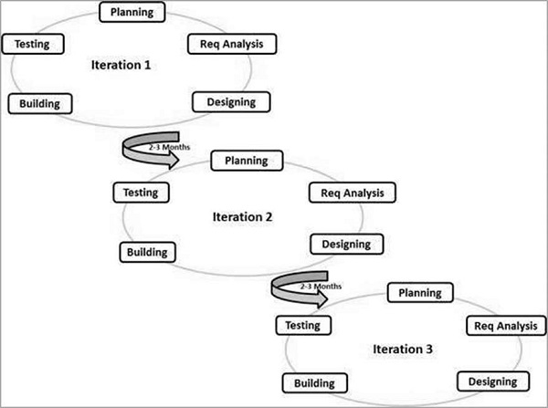
Agile Method
Key aspects of Agile focuses on iterative and incremental process. Being a model that is based on its adaptability this relies on cross functional teams being able to work simultaneously on various areas such as: Planning, Requirements, Design, Coding etc.
Splitting task up and focusing on completing parts to combine everything as certain areas are completed helps ensure there is no lapse in communication towards the final build. (“Agile Model,” Tutorial, n.d)
Agile's adaptive approach allows for no use of a rigid plan as the team adapts to the changing environment of the product requirements. Through the release iterations minimizing the risk of major failures (“Agile Model,” Tutorial, n.d).

Slide 3
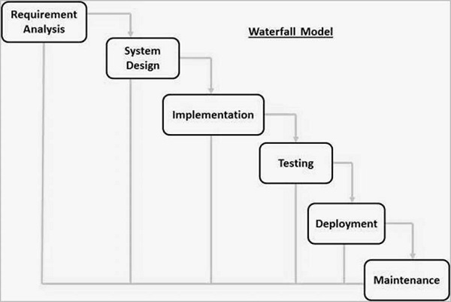
Waterfall Method
.
The waterfall method is known as the linear-sequential life cycle model that was the first process model introduced in the SDLC (“Waterfall Model,” Tutorial, n.d).
With its simple use and ability to understand this model requires one phase to be completed before moving to the next phase (“Waterfall Model,” Tutorial, n.d)..
Using this model makes it easy to arrange task but is best suitable if followed based on predetermined factors (“Waterfall Model,” Tutorial, n.d)..

Slide 4
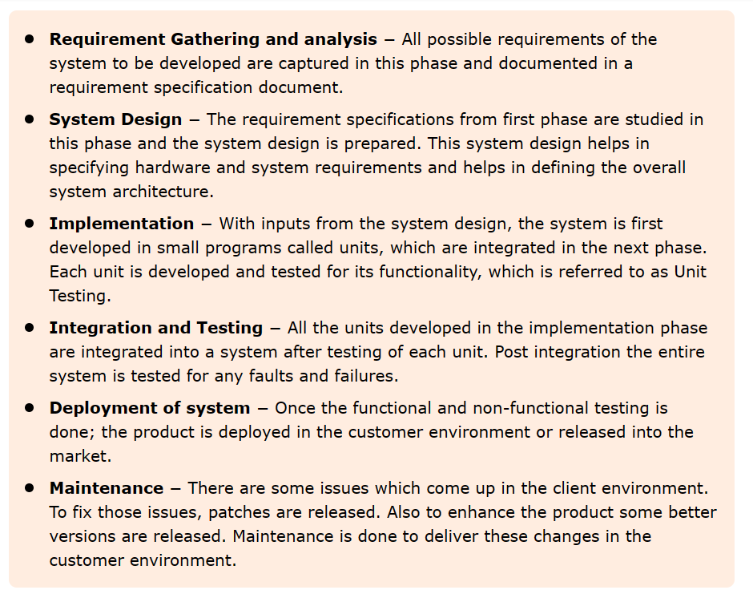
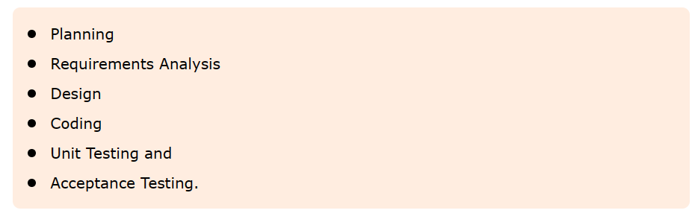
Waterfall Vs Agile
Waterfall's model is linear. Once one part is done. Then you can move to the next phase. Though this is one of the original models this model still has some uses that can be implemented depending on the type of project this model is being used for (“Waterfall Model,” Tutorial, n.d).
The waterfall approach would not have worked for this project. During the process, the client required a change to the desired outcome which cause the team to have to make adjustment to not only the code but other parts of the sprint as well. This basically would mean you would be starting over from scratch as the waterfall method does not allow adaptability like agile.
Agile's model is adaptive. Using iterations multiple task can be completed at one time repeating all the components that make up an iteration. Agile allows you go to back over task ensure builds functions appropriately to avoid failure. (“Agile Model,” Tutorial, n.d)
From this course agile's approach would be my go to approach due to its ability to adapt and flexibility. Being able to use this approach from small to big scrum teams or the way by which it is not as rigid as the waterfall method.

Slide 5
Scrum Team Roles
Product Owner: Responsible for the product backlog and maximizing the value of the development team. In a Scrum Team there is normally only 1 Product Owner who provides the direction on what will be built and prioritizes the work to be done (Cobb, 2015, pg 35).
Scrum Master: Is a servant-leader for the Scrum Team. Helping mitigate internal and external distraction and interactions with the team that aren't helpful. Serving the Product Owner as well with Product Backlog management and other task to assist the Scrum Team (Cobb, 2015, pg 36)
Development Team: Consist of different professionals who will ultimately build the required product. These members will create the increments of the sprint and keep each other accountable throughout. As a cross-functional team they will act as a single entity but cohesively as a single unit. (Cobb, 2015, pg 38)

Slide 6
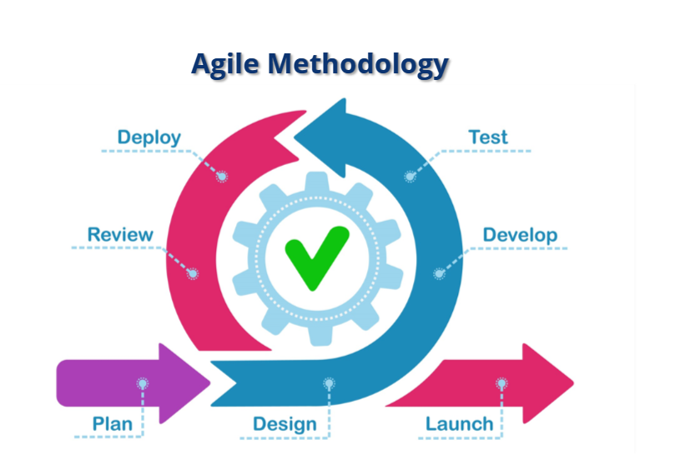
Agile Phases
There are 6 phases in the SDLC. Planning, deployment, testing, building, designing, and defining (Tutorial, n.d).
In the Agile approach during the planning phase the team would look consider estimation practices to determine how long certain task would take during the sprint.
In the Design phase, the development team would constantly be testing the build of each task to ensure everything runs accordingly as everything is put together towards the final build.

Slide 7
Tutorialspoint. (n.d.). Software Development Life Cycle (SDLC) - Agile Model. Tutorialspoint. https://www.tutorialspoint.com/sdlc/sdlc_agile_model.htm
Tutorialspoint. (n.d.). Software Development Life Cycle (SDLC) - Waterfall Model. Tutorialspoint. https://www.tutorialspoint.com/sdlc/sdlc_waterfall_model.htm
Charles G. Cobb. (2015). The Project Manager’s Guide to Mastering Agile : Principles and Practices for an Adaptive Approach. Wiley.
Tutorialspoint. (n.d.). Software Development Life Cycle (SDLC). Tutorialspoint. https://www.tutorialspoint.com/sdlc/index.htm

